Slide 1
VMware vShield – Foundation for the Most Secure Cloud Deployments

Slide 2
Agenda
Cloud Computing & Security
Security – State of the Market
Virtualization – Key Security Enabler
vShield Products
Use Cases
Summary

Slide 3

Security Market Overview
$27B Worldwide in 2009
Anti-Virus
Network Security
$9,136 (8%)
Segments We Address
Identity Mgmt
$3,565(20%)
Security Operations
Market Size($M) in 2009
$2,987 (15%)
$4,096 (7%)
Application
Security
Data Security
Endpoint Security
$3,258 (19%)
$3,001
(2%)
$713
(8%)
Source: FORRESTER, 2009
Market Growth Rate
Endpoint Security
Antivirus
Network Security
Identity Management
Market
Size in 2012
Others
Notes:
Lets start with an overview of the broad security market.
The traditional security market is a mature market segment which has over 27Billion spend – the larger segments in this market include network security, along with Identity Management, Antivirus/endpoint.
VMware vShield in it’s initial version is targeting the network security, endpoint security and application security segments to begin with. We also plan to partner closely with key vendor such as RSA, Trend, McAfee, Symantec etc to jointly address other segments.

Slide 4


Security and Compliance are the Primary Concerns with Cloud
Virtualization forms the foundation for building private clouds. Security must change to support both.
– Gartner, 2010
✓ Rate Card
? Security
✓ Hands-off
? Control
Public Cloud
✓ Self-service
? Compliance
Internal IT
Notes:
Most analyst and VMware surveys have clearly shown that the top concerns around cloud computing are security, control and compliance.
Specifically, customers are concerned about securing their applications and data in the cloud, issues around jurisdiction and data location, ability to control the security policies and to meet IT compliance requirements.
VMware vShield is intended to create disruptive change in the market - to truly help VMware based cloud deployments be more secure than any other deployment model, while also unlocking cloud benefits.

Slide 5
Agenda
Cloud Computing & Security
Security – State of the Market
Virtualization – Key Security Enabler
vShield Products
Use Cases

Slide 6
Security Challenges
  Traditional Security
  Effect
Expensive
Specialized hardware appliances
Multiple point solutions
Security “rationing”
Heightened risk exposures
Complex
Spaghetti of different rules and policies
Limited control and visibility
Organizational confusion (VI, security, network)
Hindered IT compliance
Slow provisioning
Heightened risk exposures
Rigid
Policy directly tied to implementation
Not virtualization and change-aware
VLAN sprawl
Gap between policy and enforcement
Manual re-implementation of security policies
Heightened risk exposures
Notes:
Traditional IT security has imposed many limitations and constraints that impede cloud deployments.
First, traditional solutions tend to be very expensive because of the reliance on stacking hardware based point solutions for firewalls, load balancers, VPN etc capabilities. Customers and service providers literally need to rack and stack this gear to provision security services – this greatly increases both capex as well as opex (power, space, cooling etc.).
Second, these solutions tend to be very complex to deploy – they rely on complex VLANs, sprawl in firewall rules, sprawl in the number of agents deployed – management of these solutions becomes very complex. This also complicates how security, network and VI admins work together to accomplish security and compliance goals
Third, these solutions are very rigid and brittle – there is no clear separation of security policy from implementation, and where infrastructure change is required , it takes many steps and long lead times to provision new services or change existing services.
All of these limitations increase the overall risk exposure for customers.

Slide 7
The vShield Advantage: Increased Security
  Traditional Security
  vShield
Expensive
Specialized hardware appliances
Multiple point solutions
Cost Effective
Single virtual appliance with breadth of functionality
Single framework for comprehensive protection
Complex
Spaghetti of different rules and policies
Simple
No sprawl in rules, VLANs, agents
Relevant visibility for VI Admins, network and security teams
Simplified compliance
Rigid
Policy directly tied to implementation
Not virtualization and change-aware
Adaptive
Virtualization and change aware
Program once, execute everywhere
Rapid remediation
Deployments on VMware are more secure than physical
Notes:
VMware vShield turns this all around - clouds built on VMware are actually more secure than any other deployment model.
vShield delivers cost effective solutions that are integrated services, and based on a single comprehensive framework that protects virtual datacenters from the perimeter through internal applications, data and endpoints.
vShield also significantly removes complexity by eliminating VLAN sprawl, rule sprawl and giving better control and visibility across security, network and VI admin teams.
Finally, vShield is virtualization-aware, adaptive and programmable security infrastructure – this means that VMware based clouds can be the most secure, policy-driven and react very rapidly to new security threats.

Slide 8
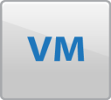
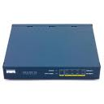
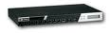
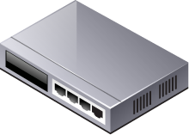
VMware Transforms Security from Expensive to Cost Effective
vShield eliminates the need for multiple special purpose hardware appliances – 3-5x Savings Capex, Opex
Load balancer
Firewall
VPN
Etc…
vShield Virtual Appliance
VMware vSphere
firewall
VPN
Load balancer
Notes:
vShield eliminates the need for special purposed appliances and hardware – by providing an integrated virtual appliance for firewall, web load balancing, VPN capabilities.
By transforming the solution from hardware appliances to software, the solution is less expensive to acquire and deploy. These virtualized network security services run very efficiently, are more scalable and deliver high performance solutions, since they can be provisioned on existing pools of vSphere resources.
In addition it delivers a solution that is more highly available, consumes less power and rack space than traditional security solutions
In summary, this reduces both Capex and Opex costs.

Slide 9



VMware Transforms Security from Complex…
Many steps. Configure
Network
Firewall
vSphere
Overlapping Roles / Responsibilities
Network admin
Define, Implement , Monitor, Refine,
Security admin
Policies, Rules
VI admin
agent
agent
agent
agent
agent
agent
agent
agent
VMware vSphere
VLAN’s
Complex
Policies, rules implementation - no clear separation of duties; organizational confusion
Many steps – configure network, firewall and vSphere
Spaghetti of VLANs, Sprawl - Firewall rules, agents
Notes:
Traditional IT security is very complex to provision and deploy. VI admins, network and security teams have overlapping roles and it takes a lot of manual coordination to properly configure and setup the network, firewall rules and vSphere configurations. Agents also get deployed in every virtual machine for basic AV, anti-malware protection.
These teams are also limited in terms of the proper role based views into policy and implementation. This results in slow provisioning, very complex configuration and sprawl in VLANs /rules/agents, significant requirements on coordination, and lack of role based views into policy and implementation details.

Slide 10
… To Disruptively Simple
Clear separation of Roles / Responsibilities
Network admin
Define, Monitor, Refine,
Few steps:
Configure vShield
Security admin
Implement
VI admin
vShield Manager + vCenter
VMware vSphere
Simple
Clear separation of duties
Few steps – configure vShield
Eliminate VLAN sprawl – vNIC firewalls
Eliminate firewall rules, agents sprawl
Notes:
vShield drastically reduces the complexity and the number of steps it takes for VI admins to implement clearly defined policies , and along with vCenter this solution enables security, network and VI admin teams to work closely together where the policies can be clearly defined, implemented, viewed and changed seamlessly.
With role-based access to administration and reporting interfaces, administration is clear and simple. VI admins are empowered to implement the security policies .The lead times it takes to provision the right set of security services is greatly reduced, and these can be done through UI’s or through scriptable, REST based APIs.
vShield technology also helps eliminate the sprawl in VLANs, firewall rules and agents. We’ll talk more about this in a few minutes when we get into the products overview.

Slide 11

VMware Turns Security from Rigid…
BEFORE vShield
  Security groups tied to physical servers
  “Air gaps”, i.e. physical isolation, between security groups
  VMs in a security group cannot be vMotioned to other hosts
DMZ
PCI compliant
“Air gap”
VMware vSphere + vCenter
VMware vSphere + vCenter
Notes:
Industry regulations often dictate that ‘in-scope’ systems – ones where regulated/sensitive data are stored or processed – have special policies applied to them. Traditional security solutions are tied to physical hosts and don’t allow flexible groupings of resources to implement these policies.
This results in what is known as ‘air-gapped’ solutions. Air gaps are created by the need for dedicated hardware and appliances. They are also created because traditional IT security requires dedicated hardware resources/clusters for specific application tiers or groups, since mixing and matching applications across tiers/groups is not possible because of the implied exposure and infection risks.
In virtualized environments, the airgap effect is just as bad, since it implies that specific groups of VMs must be limited to specific hosts. This reduces overall efficiency, imposes constraints on how applications /workloads are scaled, load balanced or otherwise managed. This also means that where datacenter-level or user driven infrastructure changes are required, a lot of manual work and cost is incurred to support such change – this leads to a very rigid infrastructure that does not adapt to changing business needs.

Slide 12
….to Adaptive
AFTER vShield
  Security groups becomes a VM construct rather than physical server construct
  Security groups enforced with VM movement
  Mix VMs from different groups on the same host
PCI Compliant
DMZ
PCI Compliant
DMZ
DMZ
VMware vSphere + vCenter
Notes:
But with vShield, virtual machines can be grouped to comply with these policies, without the need for any dedicated resources/clusters or the need to specifically ‘pin’ VMs to hosts/clusters.
vShield now fully unlocks the benefits of the cloud environment – dynamic load balancing, HA, DRS etc can be fully leveraged , and policies are tied to virtual machines as they migrate across hosts.
Now where security policies need to change, or where business needs dictate scaling / load balancing/user driven changes in the infrastructure, these can be made very easily and dynamically. – allowing your security to morph along with your virtualized or cloud infrastructure.

Slide 13
Agenda
Cloud Computing & Security
Security – State of the Market
Virtualization – Key Security Enabler
vShield Products
Use cases
Summary

Slide 14
Why VMware vShield is a Security Enabler ?
Unique introspection
Policy abstraction
Cost Effective
Single virtual appliance with breadth of functionality
Single framework for comprehensive protection
Simple
No sprawl in rules, VLANs, agents
Relevant visibility for VI Admins, network and security teams
Simplified compliance
Adaptive
Virtualization and change aware
Program once, execute everywhere
Rapid remediation
Notes:
So it’s clear that virtualized infrastructure requires virtualized security. Implementing security in the virtual environment allows for introspection at the hypervisor layer – something which physical solutions are simply not designed to do.
Since security isn’t hard-wired to the physical infrastructure, policies can be created once – with the assurance that they will be enforced regardless of how virtual machines are created, defined, or decommissioned.
And transforming all the hardware capabilities into virtualization software allows for security which is cost-effective, simple, and adaptive.

Slide 15




Security Enabler: Unique Introspection
Introspect detailed VM state and VM-to-VM communications
Processor
memory
Network
Benefits
Comprehensive host and VM protection
Reduced configuration errors
Quick problem identification
Reduced complexity – no security agents per VM required
vSphere + vShield
Notes:
Unique Introspection Capabilities Provide Comprehensive Host and VM Protection
Traditional approaches to protecting the operating system and applications have relied exclusively on agents, which are vulnerable themselves, offer protection only within limited layers of the application + OS stack, and create sprawl and management/update issues on a large scale.
The vSphere platform has unique introspection abilities and can therefore provide very comprehensive and efficient access for security controls, while obviating the need for security agents in each virtual machine. The introspection capabilities of vSphere are to security what CAT-scanners are to medical diagnostics: they can help identify hard-to-detect problems precisely and efficiently, and enable comprehensive security controls such as File Integrity Monitoring (FIM), root-kit virus protection, discovery of sensitive information, and Data Leak Protection (DLP). The introspection capabilities of vSphere result in much better performance, reduced complexity, more comprehensive host and VM protection. VMware is leveraging these introspection capabilities in the vShield security products and also exposing interfaces to our key security industry partners for integration with broader solutions such as Security Information and Event Management (SIEM), and Data Leak Protection (DLP) .

Slide 16



Security Enabler: Policy Abstraction
Separate the policy definition from the policy implementation
Before
vShield
After
vShield
Policy tied to the physical host; lost during vMotion
Policy tied to logical attributes; follow virtual machine
Benefits
Create and enforce security policies with live migration, automated VM load balancing and automated VM restart
Rapid provisioning of security policies
Easier compliance with continuous monitoring and comprehensive logging
Policy tied to logical attributes
VMware vSphere
+ vShield
Notes:
16
16
Traditional security requires that policies be anchored to the physical systems which host the critical data and services.
With vshield, security policies are tied to logical, not physical, attributes. With the decoupling and abstraction of the entire IT stack and movement to private and hybrid cloud-computing models mean that workloads and information will no longer be tied to specific devices, fixed IP or MAC addresses, breaking static security policies based on physical attributes.
To assist enterprises move beyond virtualizing their data centers to build private cloud-computing infrastructures vShield security policies shift "up the stack" to logical attributes, such as the identity, group or role of the VM being protected; the identity, group or role of the application and the sensitivity of the workload being processed.

Slide 17
Agenda
Cloud Computing & Security
Security – State of the Market
Virtualization – Key Security Enabler
vShield Products
Use cases
Summary

Slide 18

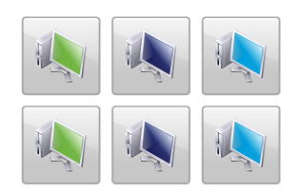
2010 – Introducing vShield Products
Securing the Private Cloud End to End: from the Edge to the Endpoint
Edge
vShield App 1.0 and Zones
vShield Endpoint 1.0
vShield Edge 1.0
Security Zone
Endpoint = VM
Secure the edge of the virtual datacenter
Application protection from network based threats
Enables offloaded anti-virus
Virtual Datacenter 1
Virtual Datacenter 2
DMZ
PCI compliant
HIPAA compliant
VMware
vShield
Web
View
VMware
vShield
VMware vShield Manager
VMware vSphere + vCenter
Notes:
There are three products in the vShield family - vShield Edge, vShield App and vShield Endpoint.
First, the vShield Edge- It secures the edge of the virtual data center.
The second product that I want to talk to you about is vShield App.
vShield App protects applications in your Virtual Data Center from network based threats
The third product is called vShield Endpoint,
vShield Endpoint is all about strengthening security for virtual machines and their hosts, while improving performance . The key benefit of this product is it streamlines and accelerates antivirus and anti-malware processing

Slide 19



vShield Edge
Secure the Edge of the Virtual Data Center
Features
VMware
vShield Edge
VMware
vShield Edge
VMware
vShield Edge
Multiple edge security services in one appliance
  Stateful inspection firewall
  Network Address Translation (NAT)
  Dynamic Host Configuration Protocol (DHCP)
  Site to site VPN (IPsec)
  Web Load Balancer
Network isolation(edge port group isolation)
Detailed network flow statistics for chargebacks, etc
Policy management through UI or REST APIs
Logging and auditing based on industry standard syslog format
Tenant A
Tenant C
Tenant X
Secure Virtual Appliance
Secure Virtual Appliance
Secure Virtual Appliance
VMware vSphere
Benefits
Lower cost and complexity by eliminating multiple special purpose appliances
Ensure policy enforcement with network isolation
Simplify management with vCenter integration and programmable interfaces
Easier scalability with one edge per org/tenant
Rapid provisioning of edge security services
Simplify IT compliance with detailed logging
Firewall
Load balancer
VPN
Notes:
So what is vshield edge and how is it LIKE what you’ve already seen in the physical data center? The solution provides a virtual appliance with the following capabilities:
DHCP – to automate IP address assignment to virtual machines in the vDC
NAT – network address translation to mask private IP addresses in the vDC when they send traffic to untrusted networks
Firewall – inbound and outbound connection control based on source/destination IP address and application port
Site to site VPN: to encrypt traffic between vDCs to allow for confidentiality between organizations or partner extranets
Web load balancer – actually load balancing based on IP address but in practice, since over 70% of server virtualization is for the web tier, organizations use load balancing for HTTP/S traffic
And for each vSphere host, the virtual network can be carved up just as a physical network can be carved up using VLANs. This “Network Isolation” keeps traffic within the organization contained within a single port group.
But while there are similarities with security in the physical world, there are key differences – and benefits – to vshield Edge over the alternatives:
1. No additional hardware: the virtual appliance with all the aforementioned edge features is provisioned using existing vsphere resources
2. No complicated VLAN rules: network isolation is enforced at the hypervisor layer, not requiring VLAN-enabled switches
3. Rapid and scalable provisioning: each ‘tenant’ gets their edge security virtually on-demand, rather than through some complicated change management process which would require budget and rack space for new edge security hardware
4. Centralized management and logging: with traditional security, each point solution would require its own management interface and logging infrastructure. With vShield, all policy management is done from one interface and logs written in syslog format to a single location. Demonstrating compliance is a breeze.

Slide 20
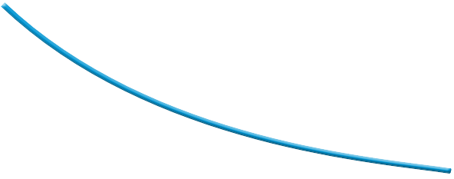
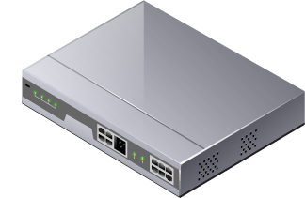
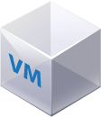
vShield Lowers Cost of Security Significantly
Network edge security solution
(Firewall + VPN + Load balancer)
Cost per Mbps
50$
Assumptions
100 VM per edge
vSphere & server costs
High availability
45$
40$
35$
30$
Security appliances
25$
20$
>5x
15$
10$
vShield Edge
5$
0$
.5Gbps
1Gbps
10Gbps
100Gbps
Mbps = Megabits/sec
Gbps = Gigabits/sec
Throughput
Notes:
BEFORE
Approximately $25K per Gbps FW and IPS
Approximately $150K for 10 Gbps FW/IPS
State of the art today is about 20 Gbps FW/IPS inspection speed for $250K; chassis alone
is about $30K
AFTER – Assuming the edge protects 100 virtual machines
Approximately $4K per 500 Mbps on vShield Edge( includes vSphere cost)

Slide 21
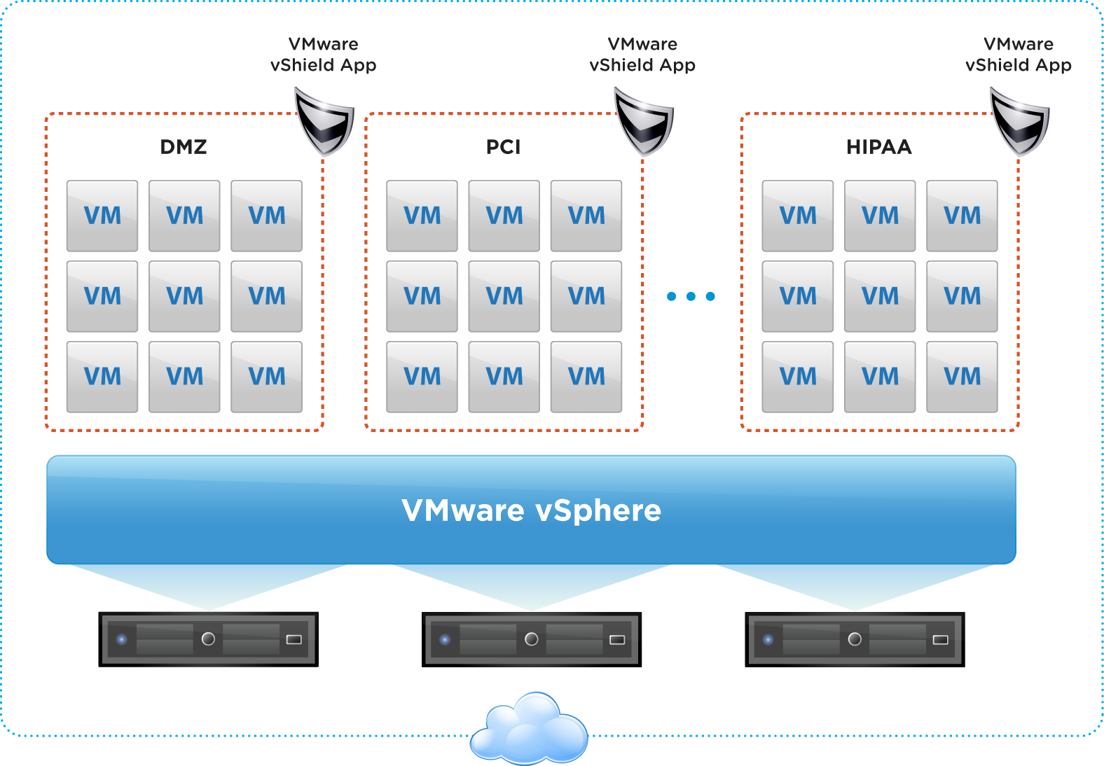

vShield App
Application Protection for Network Based Threats
Features
Hypervisor-level firewall
  Inbound, outbound connection control applied at vNIC level
  Elastic security groups - “stretch” as virtual machines migrate to new hosts
Robust flow monitoring
Policy Management
  Simple and business-relevant policies
  Managed through UI or REST APIs
Logging and auditing based on industry standard syslog format
Notes:
vShield App picks up where vShield Edge leaves off – the interior of the vDC. Since edge security cannot completely lock down all
vShield App protects applications in your Virtual Data Center from network based threats.
vShield App provides a hypervisor-based application-aware firewall to dynamically define and enforce policies for virtual machines that are supporting business critical applications.
With this product customers can define a security group, to protect a group of virtual machines that might hold credit card data that need to be PCI compliant, or another group of virtual machines that hold patient health records and need to HIPAA compliant.
So in all these cases vShield App provides a very flexible way to define policies for creating security groups where the policies can follow these virtual machines automatically in a dynamic environment.

Slide 22
vShield App Provides Adaptive Security with Policy Abstraction
Policies based on logical attributes
PCI Compliant
DMZ
PCI Compliant
DMZ
DMZ
Security groups enforced with VM movement
VMware vSphere + vCenter
Notes:
But with vShield, virtual machines can be grouped to comply with these policies, without the need for any dedicated resources/clusters or the need to specifically ‘pin’ VMs to hosts/clusters.
vShield now fully unlocks the benefits of the cloud environment – dynamic load balancing, HA, DRS etc can be fully leveraged , and policies are tied to virtual machines as they migrate across hosts.
Now where security policies need to change, or where business needs dictate scaling / load balancing/user driven changes in the infrastructure, these can be made very easily and dynamically. – allowing your security to morph along with your virtualized or cloud infrastructure.

Slide 23
vShield App
Application Protection for Network Based Threats
Features
Hypervisor-level firewall
  Inbound, outbound connection control applied at vNIC level
  Elastic security groups - “stretch” as virtual machines migrate to new hosts
Robust flow monitoring
Policy Management
  Simple and business-relevant policies
  Managed through UI or REST APIs
Logging and auditing based on industry standard syslog format
Benefits
Increase visibility for inter-VM communications
Eliminate dedicated hardware and VLANs for different security groups
Optimize resource utilization while maintaining strict security
Simplified compliance with comprehensive logging of inter VM activity
Notes:
The key benefits of this product are –
First, It gives organizations deep visibility into network communications between virtual machines.
Second, it eliminates the hardware and policy sprawl associated with using traditional appliances to secure virtualized applications and
finally it optimizes hardware resource utilization while maintaining strong security.
vShield App provides a hypervisor-based application-aware firewall to dynamically define and enforce policies for virtual machines that are supporting business critical applications.
With this product customers can define a security group, to protect a group of virtual machines that might hold credit card data that need to be PCI compliant, or another group of virtual machines that hold patient health records and need to HIPAA compliant.
So in all these cases vShield App provides a very flexible way to define policies for creating security groups where the policies can follow these virtual machines automatically in a dynamic environment.

Slide 24
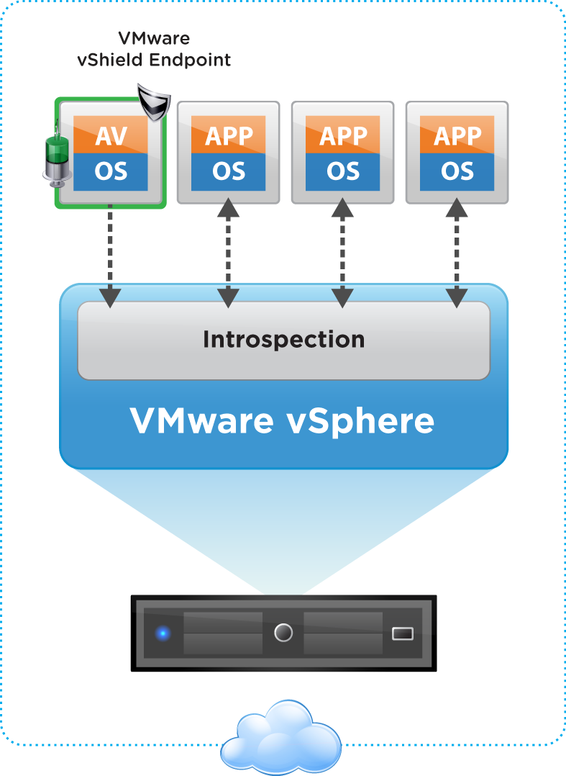
vShield Endpoint
Offload Anti-virus Processing for Endpoints
Features
Eliminate anti-virus agents in each VM; anti-virus off-loaded to a security VM delivered by AV partners
Enforce remediation using driver in VM
Policy and configuration Management: through UI or REST APIs
Logging and auditing
Benefits
Improve performance by offloading anti-virus functions in tandem with AV partners
Improve VM performance by eliminating anti-virus storms
Reduce risk by eliminating agents susceptible to attacks and enforced remediation
Satisfy audit requirements with detailed logging of AV tasks
Notes:
The third product we are introducing is called vShield Endpoint,
vShield Endpoint is all about strengthening security for virtual machines and their hosts, while improving performance . The key benefit of this product is it streamlines and accelerates antivirus and anti-malware processing.
Today, customers deploy an agent in every virtual machine to secure them, but that's very expensive because it causes AV storms and performance issues, and the agents are themselves vulnerable to attack.
So vShield Endpoint enables the ability to offload anti-virus processing to a single security virtual machine.
And our security partners such as Trend Micro are going to be shipping a solution based on Endpoint in 2010,
and additional partners such as McAfee and Symantec will be shipping solutions in the near future based on this solution.

Slide 25
Agenda
Cloud Computing & Security
Security – State of the Market
Virtualization - Key Security Enabler
vShield Products
Use cases
Summary

Slide 26




Service Provider - Offering Multi-Tenant Hosting Service
Vmware vCloud Director
Requirements
vShield
Edge
Company A
Company B
Company C
Host potentially hundreds or thousands of tenants in shared infrastructure with:
  Traffic Isolation between the tenants
  Complete protection and confidentiality of tenant apps and data
  Integration with enterprise directory services (e.g. Active Directory)
  Complying with various audit requirements
VMware vSphere + vCenter + vShield
Solution – vShield Edge,
VMware Cloud Director
Guarantee full confidentiality and protection of tenant apps and data with built-in firewall and VPN
Use enterprise directory services for security policies
Accelerate compliance by logging all traffic information on per-tenant basis
Lower cost of security by 100+% by eliminating purpose built appliances and by increasing utilization and VM density
Cisco VPN
Checkpoint VPN
Juniper VPN
Company A
Company B
Company C
Notes:
Cloud computing requires that multiple tenants are assured of availability and privacy through network isolation, a private IP address space, encrypted communication to enterprise networks, and continuous monitoring of traffic crossing the edge of the virtual data center.
VMware vShield edge addresses these requirements with a single solution encompassing a stateful firewall, site-to-site VPN, load balancing, network isolation, NAT, and DHCP services.

Slide 27


Enterprise - Securing Business Critical Applications
Requirements
VMware
vShield App
Deploy production and development applications in a shared infrastructure with:
  Traffic segmentation between applications
  Authorized access to applications
  Strict monitoring and enforcement of rules on inter-VM communications
  Ability to maintain security policies with VM movement
  Compliance to various audit requirements
DMZ
Development
Finance
VMware vSphere + vShield
Solution - vShield App + Edge
Protect data and applications with hypervisor level firewall
Create and enforce security policies with virtual machine migration
Facilitate compliance by monitoring all application traffic
Improve performance and scalability with load balancer and software based solution
Development
Finance
Notes:
Both corporate governance and industry regulations mandate that confidential data only be made accessible on a need-to-know basis within the enterprise.
Enterprises segregate and isolate networks based on business function – such as finance, sales, software development – using VLANs and departmental application firewalls.
VMware vShield App eliminates the complexity and cost of these approaches through Security Groups to segregate traffic and an application firewall with deep visibility to filter traffic between virtual machines.
The solution goes even further to monitor ‘flows’ of traffic, independent from firewall rules,.
It reports on all applications, sessions, bytes and other details, allowing administrators to define and refine their policies based on actual traffic patterns.

Slide 28





Enterprise - Secure View Deployments
Requirements
VMware
vShield App
Support thousands of internal and external View users with:
  Comprehensive security for View servers
  Anti virus agents to protect client data and applications
  Optimal performance and scalability
DMZ
View Desktops
VMware vSphere + vShield
Public Network
Private Network
Solution - vShield Endpoint+App+Edge
Improve performance by offloading AV processing
Reduce costs by freeing up virtual machine resources and eliminating agents
Improve security by streamlining AV functions to a hardened security virtual machine(SVM)
Protect View application servers from threats
Demonstrate compliance and satisfy audit requirements with detailed logging of offloaded AV tasks
Remote User
Local User
Notes:
Finally the virtual desktops and ThinApp applications can be expanded to external end-users who are mobile or in remote offices.
VMWare View customers enjoy the simplicity and flexibility of the desktop as a managed service, yet many customers contend with sluggish performance, high resource utilization, and complicated anti-virus management by requiring that anti-virus be deployed in every virtual desktop image.
VMware vShield Endpoint offloads AV functions to a hardened security virtual machine (SVM), which is provided by endpoint security partners, to address management, performance and resource utilization issues while improving security.

Slide 29
Agenda
Cloud Computing & Security
Security – State of the Market
Virtualization – Key Security Enabler
vShield Products
Use cases
Summary

Slide 30
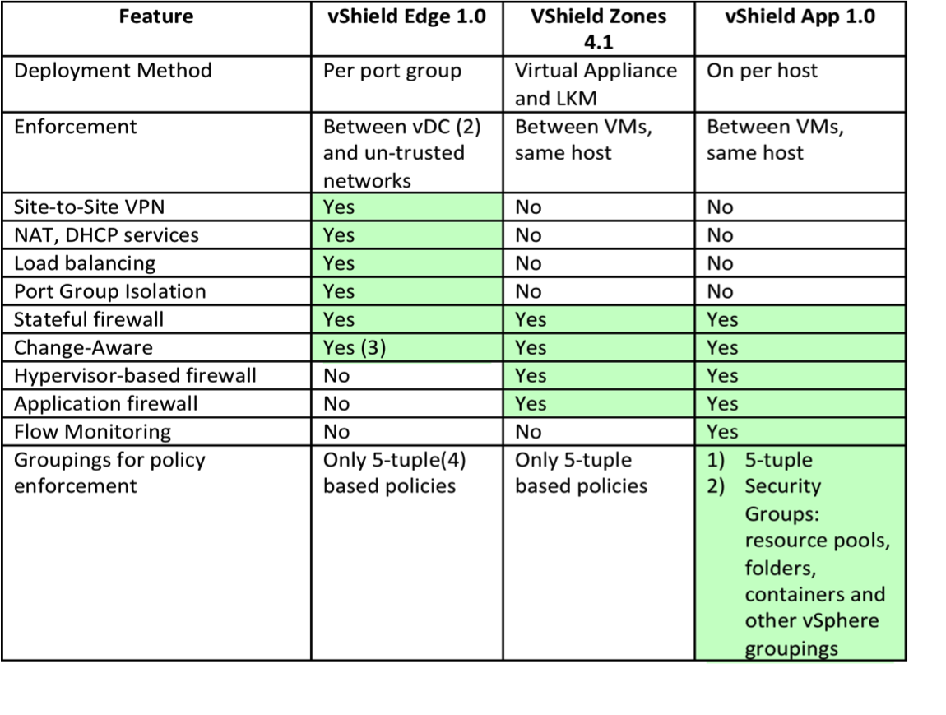
vShield Edge 1.0 vs. vShield Zones 4.1 vs. vShield App 1.0
Notes:
Here is a summary of the products and features.

Slide 31
vShield Products
Product SKUs | List/VM | SnS
vShield Edge 1.0 | $150 | Standard Basic, Production
vShield Endpoint 1.0 | $50 | Standard Basic, Production
vShield Zones for vSphere 4.1 (Included in vSphere Advanced and above) | NA | vSphere SnS applies
vShield App 1.0 (includes Endpoint and Zones) | $150 | Standard Basic, Production
Upgrade to full vShield Edge 1.0 from VMware Cloud Director | $110 | Standard Basic, Production
Upgrade to vShield App 1.0 from vShield Endpoint 1.0 | $110 | Standard Basic, Production
Notes
VMware Cloud Director – Includes vShield Edge subset(Firewall, DHCP, NAT)
vShield App – Includes vShield Endpoint
VMware View 4.5 Premier SKUs – Include vShield Endpoint 1.0
All SKUs – Min 25-VM purchase
Notes:
The products are priced on a per VM model.
All products work with vSphere Essentials plus and above.
The firewall in vShield Edge product is bundled with vCloud director. By upgrading to full vShield Edge product , you get the VPN and loadbalancing features.
vShield Endpoint is bundled with View Premier 4.5.

Slide 32
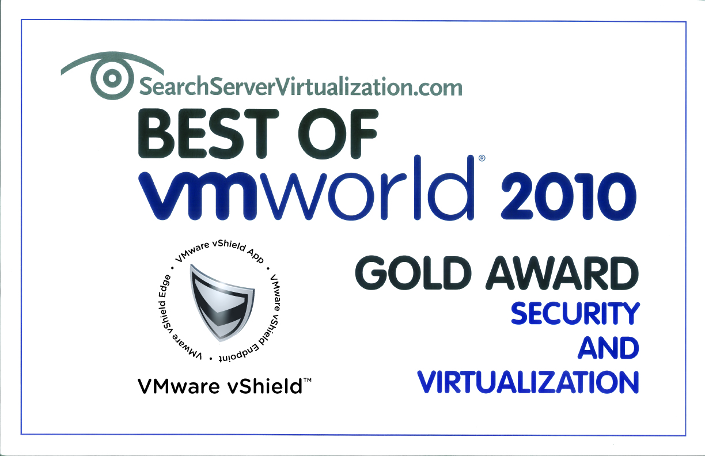
vShield Wins Best of VMworld 2010
“VMware vShield marks a major improvement in security. It includes many essential features for virtualization security, and the ability to isolate traffic for different port groups is a highlight”
Notes:
vShield won Best of VMworld 2010 in Security and Virtualization category.

Slide 33
Quotes
“Definitely, the integration of vShield, offering application, network and end point security for the cloud, is a big step..” – CloudAve, Krishnan Subramanian
“The vision of moving legacy and new applications between public and private clouds necessitates a virtual security approach that surpasses static edge filtering commonly found in AV, IPS and firewalls.” – ComputerWorld, Eric Ogren
“You’ve got to hand it to VMware …..this week’s VMworld, the company announced the VMware vShield family of security products.” – Enterprise Strategy Group, Jon Oltsik
“vShield should help IT managers ensure that VMs can be protected and isolated in the virtual network with technology that is baked into the virtualization infrastructure.” – eWEEK, Cameron Sturdevant
“VMware has finally taken virtual machine security and added it through the entire virtualization stack.. The dark horse feature of this product? Load balancing. I tried it in the lab – it takes 30 seconds to set up load balancing. No more need for expensive F5’s – this could be a real game changer.” – Brandon Hahn
Notes:
Here are some quotes….

Slide 34
Thank You

