Slide 1
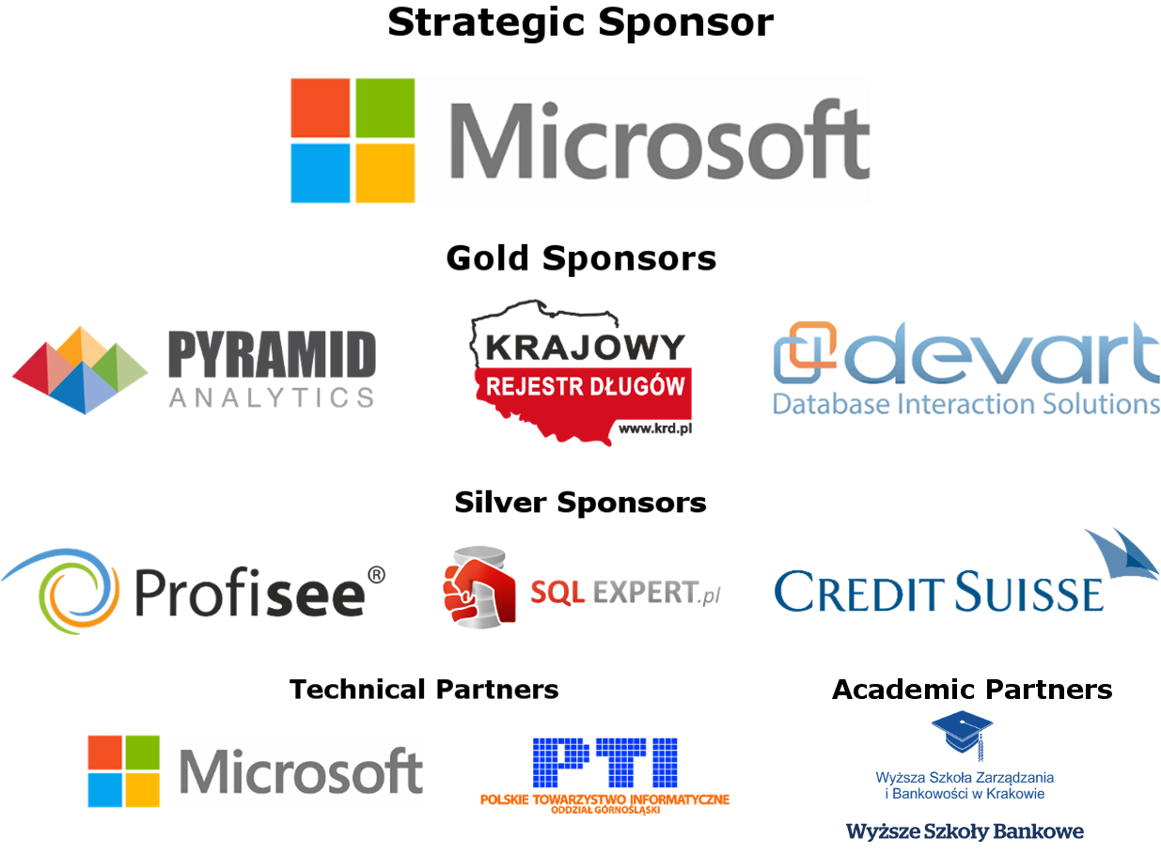
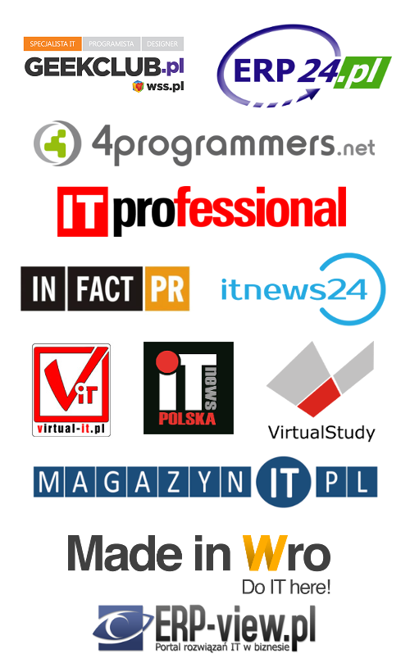
Media Partners

Slide 2
Upgrading to SQL Server 2014
Michał Sadowski
PLSSUG Kraków
michal.sadowski@plssug.org.pl
@SadowskiMichal

Slide 3


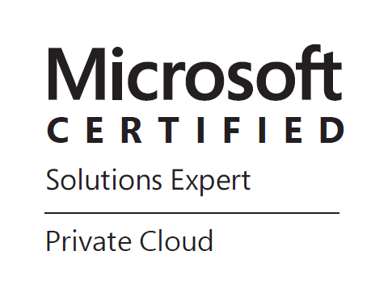
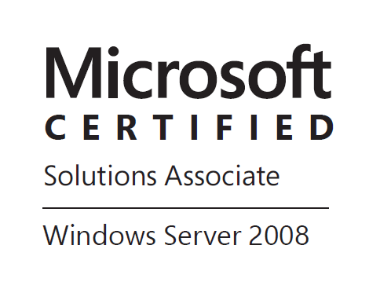
Few words about me
Leader of PLSSUG Kraków
DBA of financial applications
  in international corporation
MCP since 2005
MCITP: SQL Server DBA 2005/2008
Interests:
  Disaster Recovery
  Performance tuning
Notes:
Hello, let’s start!
Few words about me – I am working in international corporation as DBA of financial applications
Have experience with Microsoft technology since 2005 – I have started my jurney with Windows Server 2003 and SQL Server 2000

Slide 4
Overview
Reasons for upgrade
Upgrade strategies
Possible upgrade paths
Tools
Demo
Best Practices
Summary

Slide 5
Reasons for upgrade
End of mainstream support
New features:
  In-memory OLTP
  Updateable clustered columnstore index
  Delayed durability
  AlwaysOn
  SQL 2014 on Windows Core
  Better BI tools
Hardware upgrade
Consolidation
Notes:
If you are comfortable with current solution – stay with it
AlwaysOn – use secondaries for reporting, backups, loading datawarehouse and other activities

Slide 6
Mainstream and extended support
Version | Mainstream | Extended
SQL Server 2000 SP4 | 08-04-2008 | 09-04-2013
SQL Server 2005 SP4 | 12-04-2011 | 12-04-2016
SQL Server 2008 SP4 | 08-04-2014 | 09-07-2019
SQL Server 2008 R2 SP3 | 08-04-2014 | 09-07-2019
SQL Server 2012 SP2 | 11-07-2017 | 12-07-2022
SQL Server 2014 SP1 | 09-07-2019 | 09-07-2024
https://support.microsoft.com/en-us/lifecycle

Slide 7
Hotfix vs Patch vs Cumulative Update vs Service Pack
Patch - Publicly released update to fix a known bug/issue
Hotfix - update to fix a very specific issue, not always publicly released
Cumulative Update - Incremental update between service packs or software versions to fix multiple outstanding issues
Service Pack - A tested, cumulative set of all hotfixes, security updates, critical updates, and updates, sometimes features

Slide 8
Upgrade strategies
In-place upgrade – use setup program to directly upgrade an instance of SQL Server 2005, 2008, 2008 R2 or 2012. Older instance is replaced
Side-by-side upgrade:
  One server – The new instance exists on the same server as the target instance
  Two servers - The new instance exists on a different server than the target instance

Slide 9

In-place upgrade
SQL Server 2005/
2008/2008R2/
2012 instance
SQL Server 2014 instance

Slide 10
Side-by-side upgrade on the same server
SQL Server 2005/
2008/2008R2/
2012 instance (unchanged)
SQL Server 2005/
2008/2008R2/
2012 instance
New SQL Server 2014 instance

Slide 11
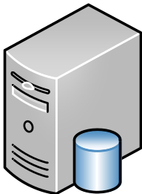
Side-by-side upgrade
Old instance of SQL Server remains unchanged
SQL Server 2005/
2008/2008R2/
2012 instance
New SQL Server 2014 instance

Slide 12
Considerations for choosing an upgrade strategy
Components
Editions
Partial upgrade
Upgrading over time
Effect on application
Availability
Rollback
Notes:
Components: SSIS, SSAS, Engine itself
Editions: like Enterprise to Standard edition
Partial upgrade: move only few databases and leave the rest on the legacy version
Upgrading over time: To transition database graually
Effect on application: if your organization requires minimal disturbance to the existing app and user, choose wisely
Availability: both in-place and side-by-side requires that db be unavailable for some time
Rollback: for many db systems in production it is imposible to justify a change without a rollback strategy

Slide 13
Planning for an upgrade
Backward compatibility
Deprecated Features
Discontinued Features
Breaking Changes
Behavior Changes
Notes:
These features are scheduled to be removed in a future release of SQL Server. Deprecated features should not be used in new applications.
Eg. Compatibility level 90 in 2014
These changes might break applications, scripts, or functionalities that are based on earlier versions of SQL Server.
E.g. PIVOT inside CTE
ALTER TABLE needs to
New columns in DMVs or catalog views
New collations
Xquery datetime support - in 2005 default time zone of UTC is mapped in 2008+
Trace flag changes
Behavior changes affect how features work or interact in SQL Server 2014 as compared to earlier versions of SQL Server.
E.g. new options to page verify
Scripting sql agent job
Length of xml string (more than 4020 chars)

Slide 14
Possible version upgrade paths
SQL 2000 SP4
SQL 2014
SQL 2005 SP4
SQL 2008 SP3
SQL 2008R2 SP2
SQL 2012 SP1

Slide 15
Possible edition upgrade paths
SQL Server 2005 - 2012
Express
SQL Server 2014
Workgroup
Express
Web
Web
Small Business
Standard
Standard
Business Intelligence
Business Intelligence
Developer
Datacenter
Enterprise
Developer
Enterprise

Slide 16
Tools
SQL Server 2014 Upgrade Advisor
Best Practices Analyzer for SQL Server
SQL Server 2014 Setup: System Configuration Checker
Upgrade Assistant for SQL Server 2012 (UAFS) plays together with Distributed Replay
RMLUtils
SQL Server Profiler/Extended Events
System Monitor – SQL Server: Deprecated Features Object
Custom scripts*
Notes:
Sp_WhoIsActive
Login_sync script
Ola Hallengreen maintenance scripts

Slide 17
Demo
Northwind
Northwind
SQL 2000 SP4
SQL 2005 SP4
SQL 2014

Slide 18
DEMO #2
Upgrade from SQL Server 2000 to SQL Server 2014
Notes:
Compatibilty level increase
DBCC UPDATEUSAGE

Slide 19
DEMO #2
Using mirroring for upgrade
Notes:
Compatibilty level increase
DBCC UPDATEUSAGE

Slide 20
Demo #2
SQL 2005 SP4
SQL 2014
Mirroring
AdventureWorks
AdventureWorks

Slide 21
Best Practises
Take side-by-side (new installation) option if possible
Prepare new instance in advance:
  SQL logins
  SQL jobs
  Extended Events with deprecated features
  Prepare step-by-step migration plan (document) with rough time estimation and rollback description
  Prepare test cases for baselining new instance
  Use SQL Server Agent jobs whenever possible to automate all tasks
  Rebuild all indexes after upgrade

Slide 22
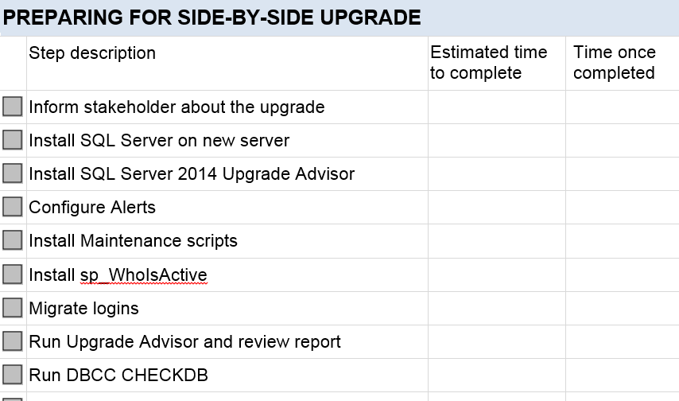
Document all steps

Slide 23
Summary
Start preparation early and plan well
Be ready for rollback
Check the timing
Don’t forget about backups after each major step
Practice, practice and practice

Slide 24

To learn more, go here:
SQL Server 2014 Upgrade technical guide
Microsoft SQL Server 2014 Upgrade Advisor
SQL Server 2012 Best Practices Analyzer
Discontinued Database Engine Functionality
Breaking Changes to SQL Server Features
Microsoft Virtual Academy
  http://bit.ly/SQLDay2015-Upgrade

Slide 25
for help, contact me michal.sadowski@plssug.org.pl
@SadowskiMichal

Slide 26
THANK YOU!

Slide 27
Media Partners

